Slide 1

Who decides
what happens
in the classroom?
Faculty Academic Freedom
Keyishian · Axson-Flynn · Texas
01
Notes:
Faculty Academic Freedom. Approximately 40–45 minutes. Later Group 1 and Group 2 presentations are separate and unrelated. Illustrations throughout are AI-generated conceptual artwork.

Slide 2
A student refuses
A professor assigns students to argue a position they personally oppose.
A student refuses. Completing the assignment is necessary to pass.
Should the professor be able to require this?
02
Notes:
Opening scenario. Require a yes-or-no vote, then one minute with a partner to explain the assumption behind the choice.

Slide 3
Your first decision
YES
NO
With a partner: What assumption are you making?
1 minute
03

Slide 4
Academic freedom involves competing claims
STATE
UNIVERSITY
Laws governing public institutions
Authority over curriculum
FACULTY
STUDENT
Professional judgment in teaching
Expression and religious exercise
04

Slide 5
The questions we will keep asking
01 Who imposes the requirement?
02 What does it actually require?
03 What supports the justification?
A way to organize the dispute, rather than a single legal test
05

Slide 6

1967
Keyishian v.
Board of Regents
State loyalty requirements
and university employment
U.S. Supreme Court · 385 U.S. 589
06
Notes:
Source: https://supreme.justia.com/cases/federal/us/385/589/

Slide 7
Employment depended on loyalty rules
The requirements
The constitutional problem
Certifications involving Communist affiliation
Rules addressing “subversive” activity and association
Unclear boundaries
Restrictions reaching protected expression and association
The Court invalidated challenged provisions.
07
Notes:
Source: https://supreme.justia.com/cases/federal/us/385/589/

Slide 8
Vagueness
“What exactly could get me fired?”
Overbreadth
“How much protected expression
does this rule reach?”
08
Notes:
Source: https://supreme.justia.com/cases/federal/us/385/589/
Teaching paraphrases of vagueness and overbreadth.

Slide 9
Before anyone faces discipline
Your employment depends on avoiding
“subversive” teaching.
What might you stop assigning or discussing?
Partner discussion · 1 minute
09

Slide 10
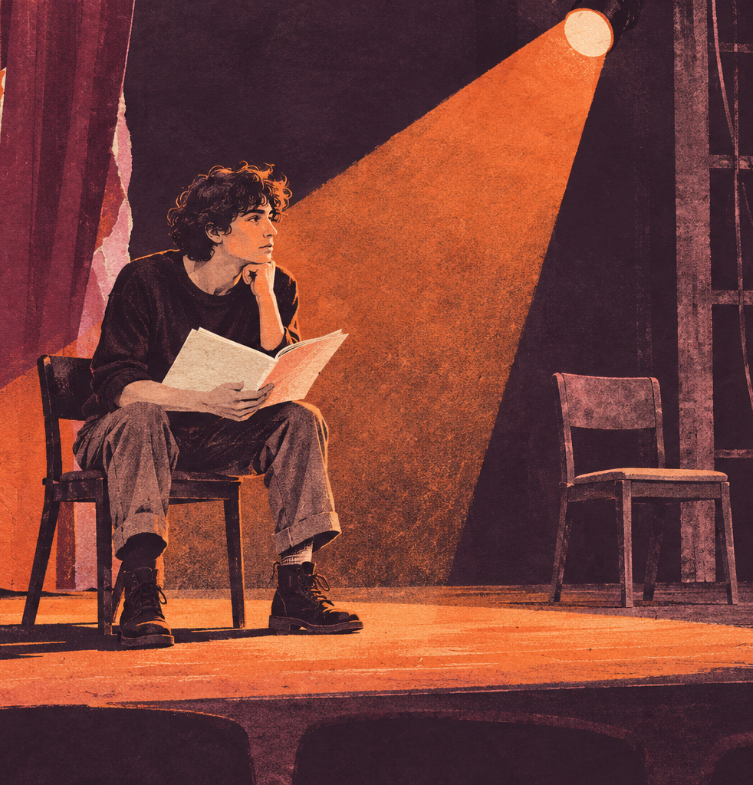
2004
Axson-Flynn
v. Johnson
An acting requirement meets
a religious objection
Tenth Circuit · 356 F.3d 1277
10
Notes:
Source: https://law.justia.com/cases/federal/appellate-courts/F3/356/1277/539809/

Slide 11
The dispute in the rehearsal room
The student
The instructors
Objected on religious grounds to particular words in scripts.
Defended script adherence as part of professional acting training.
She left the program and challenged the requirements.
11
Notes:
Source: https://law.justia.com/cases/federal/appellate-courts/F3/356/1277/539809/

Slide 12
Educational judgment and pretext
What could justify requiring
the original words?
What evidence would cast doubt
on that explanation?
Pretext: a stated reason that conceals the actual reason
Discuss both questions with a partner.
12
Notes:
Source: https://law.justia.com/cases/federal/appellate-courts/F3/356/1277/539809/
Invite examples: script interpretation and professional skills. Evidence raising questions may include religious hostility and unexplained exceptions.

Slide 13
What the court decided
Legitimate educational requirements
receive room for professional judgment.
Disputed evidence about discrimination
and pretext required further proceedings.
Reversal and remand. No final finding that discrimination occurred.
13
Notes:
Source: https://law.justia.com/cases/federal/appellate-courts/F3/356/1277/539809/
The court reversed summary judgment and remanded. The opinion addresses free speech and free exercise claims. Tenth Circuit precedent is persuasive rather than binding in Texas, which is in the Fifth Circuit.

Slide 14

The Texas
classroom
SB 17 and SB 37
Statutory scope
and curriculum authority
14
Notes:
Sources: https://capitol.texas.gov/tlodocs/88R/billtext/html/SB00017F.htm and https://capitol.texas.gov/tlodocs/89R/billtext/html/SB00037F.HTM

Slide 15
SB 17
DEI offices and specified institutional practices
The law restricts specified DEI activities
at public institutions.
Academic course instruction and scholarly research
or creative work are expressly excluded from
subsection (b)(1)’s prohibitions.
2023 · Texas Education Code §51.3525(d)
15
Notes:
Source: https://capitol.texas.gov/tlodocs/88R/billtext/html/SB00017F.htm
SB 17, 88th Legislature (2023), Education Code §51.3525(b)(1), (d). The exception applies specifically to subsection (b)(1). Do not describe it as immunity from other laws or institutional academic policies.

Slide 16
SB 37
Curriculum oversight and shared governance
Governing boards review general education
curricula at least every five years.
Curriculum decisions occur under board direction.
Faculty input is advisory within the statutory
shared governance framework.
2025 · Texas Education Code §§51.315, 51.354, 51.3523
16
Notes:
Source: https://capitol.texas.gov/tlodocs/89R/billtext/html/SB00037F.HTM
SB 37, 89th Legislature (2025), §§51.315, 51.354, 51.3523. General applicability begins January 1, 2026, with separate faculty senate transition provisions.

Slide 17
A course can involve both laws
Could academic instruction fall outside
SB 17’s specified prohibitions and still
undergo curriculum review under SB 37?
What does each law govern?
Partner discussion · 1 minute
17
Notes:
Sources: https://capitol.texas.gov/tlodocs/88R/billtext/html/SB00017F.htm and https://capitol.texas.gov/tlodocs/89R/billtext/html/SB00037F.HTM
Expected answer: yes. The statutes address different questions. An instruction exclusion under SB 17 does not exempt a course from curriculum governance under SB 37.

Slide 18
Oklahoma
Fulnecky and the grading dispute
A psychology student received zero on a reaction paper that used religious arguments about gender.
The student alleged religious discrimination.
The instructor said the paper failed the assignment criteria.
November–December 2025 · University of Oklahoma
18
Notes:
Sources: https://www.oudaily.com/news/ou-bible-essay-graduate-instructor-samantha-fulnecky/article_4d684bc2-160a-4720-9701-9fcdc6858f44.html and https://www.reuters.com/world/us/oklahoma-university-graduate-student-barred-teaching-over-gender-essay-grading-2025-12-23/
Present as a disputed grading controversy. The student alleged discrimination. The instructor defended the academic basis of the assessment.

Slide 19
The institutional response
OU removed the assignment from
the student’s final grade calculation.
OU described the grading as arbitrary
and ended the instructor’s teaching duties.
The instructor disputed that conclusion.
An administrative conclusion does not establish a judicial finding.
19
Notes:
Source: https://www.oudaily.com/news/ou-bible-essay-graduate-instructor-samantha-fulnecky/article_4d684bc2-160a-4720-9701-9fcdc6858f44.html
OU characterized the grading as arbitrary following a review of grading patterns and statements, removed the assignment from the final grade calculation, and ended Curth’s instructional duties. The instructor disputed the conclusion. The university did not publicly release the discrimination investigation findings. Distinguish an administrative determination from a court judgment.

Slide 20
Texas A&M
McCoul and the course content dispute
A recording of a children’s literature class
showing discussion of gender identity
circulated publicly.
Political criticism followed.
A&M dismissed senior lecturer Melissa McCoul.
September 2025 · Classroom content and institutional authority
20
Notes:
Sources: https://www.texastribune.org/2025/09/15/texas-am-professor-firing-melissa-mccoul-academic-freedom/ and https://www.texastribune.org/2025/09/19/texas-a-m-welsh-firing-professor-gender-mccoul/
The classroom recording came from a summer course and circulated widely in September. Do not imply that September was the date of the recorded lesson.

Slide 21
The disagreement over the rationale
A&M’s explanation
The challenge
Course content did not align
with the approved description.
The instructor had not followed
directions to change it.
McCoul disputed the rationale.
A faculty review later found
the firing violated
academic freedom.
The faculty review was an internal determination, rather than a court judgment.
21
Notes:
Sources: https://www.texastribune.org/2025/09/15/texas-am-professor-firing-melissa-mccoul-academic-freedom/ and https://www.texastribune.org/2025/11/10/texas-am-mccoul-firing-academic-freedom-council/
A&M cited failure to follow directions to align content with course descriptions. Her attorney disputed the rationale. A faculty Academic Freedom Council later concluded that the firing violated academic freedom and that the catalog, description, and syllabus were consistent. This was a faculty review, not a judicial ruling.

Slide 22
Which intervention is more defensible?
A Oklahoma’s response to the grade
B A&M’s response to the course content
Choose A or B. Defend your choice with a legal principle
and one piece of evidence you would examine.
Partner discussion · 2–3 minutes
22
Notes:
Allow 2–3 minutes. Require a position. Students compare institutional intervention, rather than deciding final legal liability. Strong answers explain the difference between reviewing a grade and removing teaching duties, and between curriculum oversight and retaliatory dismissal. Ask each pair to name a record that could challenge its own position.

Slide 23
What would the records show?
Oklahoma
Texas A&M
Assignment and grading rubric
Feedback on the paper
Consistency across submissions
Course description and syllabus
Directions to the instructor
Timing and basis of dismissal
Texas laws provide context. SB 17 does not govern OU. SB 37’s general application began in 2026.
23
Notes:
Sources: https://capitol.texas.gov/tlodocs/88R/billtext/html/SB00017F.htm and https://capitol.texas.gov/tlodocs/89R/billtext/html/SB00037F.HTM
This slide provides analytic connections, not a claim that either statute caused these incidents. SB 17 is Texas-specific and does not govern Oklahoma. SB 37 was enacted in 2025, effective September 1, with general applicability January 1, 2026 and special senate transition provisions. Do not present its 2026 framework as the operative rule governing McCoul’s September 2025 dismissal.

Slide 24
Before the dispute escalated
What could the instructor have done earlier?
What could the university have done differently?
Choose one realistic action for each.
Explain how it protects academic standards and fair treatment.
24
Notes:
Activity: allow 2–3 minutes. Ask each pair for one feasible action by the instructor and one by the institution. These are prospective teaching recommendations, not findings of fault or claims that controversy was preventable. Possible answers: explicit evidence criteria and grading feedback, a second academic review, early clarification of curriculum expectations, and a documented process before employment action.

Slide 25
Earlier choices worth considering
Oklahoma
Texas A&M
State the evidence requirements.
Explain deductions through
the grading rubric.
Use a second academic review
when a grade is contested.
Clarify curriculum expectations
before the course begins.
Review the full academic record.
Hear the instructor’s response
before employment action.
These steps can support a fair process. They cannot guarantee that controversy will not occur.
25
Notes:
Suggested practices for discussion, not factual findings about what either party did or failed to do. Instructors can clarify grading criteria, connect feedback to the rubric, and obtain an independent academic review. Institutions can clarify course expectations, examine the full record, and provide the applicable response and appeal process before employment decisions. These practices may reduce avoidable escalation but cannot guarantee prevention of political controversy.

Slide 26
The cases help us ask better questions
Keyishian
Axson-Flynn
How can state restrictions
pressure faculty toward
ideological conformity?
What justifies the requirement?
What could undermine
that explanation?
26
Notes:
Sources: https://supreme.justia.com/cases/federal/us/385/589/ and https://law.justia.com/cases/federal/appellate-courts/F3/356/1277/539809/
These are conceptual connections for analysis, not claims that either precedent conclusively resolves SB 17, SB 37, or these contemporary disputes.

Slide 27
Your decision, revisited
Can a professor require students to argue
a position they personally oppose?
“The most important distinction
I would make is…”
27
Notes:
Closing yes-or-no vote and exit response. Invite two brief explanations of whether reasoning changed. End the lesson before unrelated group presentations.

Slide 28
Cases and statutory text
Keyishian v. Board of Regents
385 U.S. 589 (1967)
Axson-Flynn v. Johnson
356 F.3d 1277 (10th Cir. 2004)
Texas SB 17 (88R, 2023)
Education Code §51.3525
Texas SB 37 (89R, 2025)
Education Code §§51.315, 51.354, 51.3523
28
Notes:
Sources contain the enacted statutory text and judicial opinions. All illustrations are AI-generated conceptual artwork, not documentary photographs.

Slide 29
Contemporary examples: sources
Oklahoma
OU Daily · December 22, 2025
Reuters · December 23, 2025
Texas A&M
The Texas Tribune · September 15, 2025
The Texas Tribune · November 10, 2025
29
Notes:
Contemporary sources:
https://www.oudaily.com/news/ou-bible-essay-graduate-instructor-samantha-fulnecky/article_4d684bc2-160a-4720-9701-9fcdc6858f44.html
https://www.reuters.com/world/us/oklahoma-university-graduate-student-barred-teaching-over-gender-essay-grading-2025-12-23/
https://www.texastribune.org/2025/09/15/texas-am-professor-firing-melissa-mccoul-academic-freedom/
https://www.texastribune.org/2025/11/10/texas-am-mccoul-firing-academic-freedom-council/
Use the events as documented in these dated accounts. No final judicial outcome is asserted.

